Slide 1
WELCOME

Slide 2

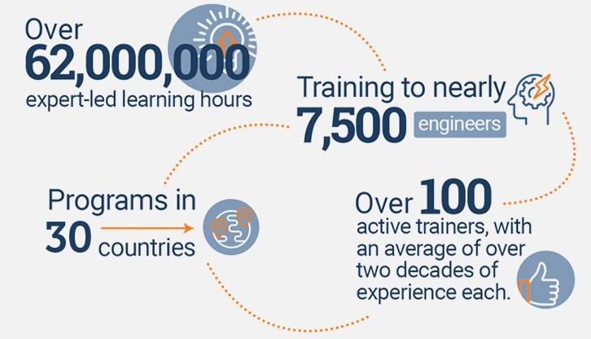
An Overview
Our purpose…
We help organizations learn and adopt new technologies.
In 2018 alone...
…Impacts you daily.
When you talk on the phone, watch a movie, connect with friends on social media, drive a car, fly on a plane, pay with a credit card, shop online, and order a latte with your mobile app, you are interacting with technology developed by one of our customers.
Notes:
Share a bit about DevelopIntelligence
- As developers you want to learn!
- As a corporation you want your developers to align their learning with your business goals.
- That’s where we come in… Keeping developers current, bringing others up-to-speed … all aimed at moving your business forward!
- We started in 2003 by a Sun Microsystems developer that wanted to help developers level-up and see business better leverage IT

Slide 3
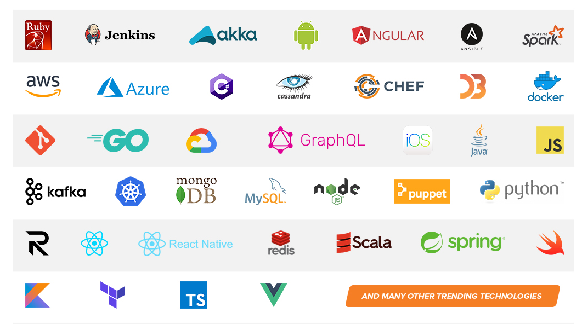
Technologies we cover
Notes:
Areas of DevelopIntelligence expertise
DevOps: Ansible / Jenkins
BigData: Hadoop / Cassandra / Spark
Machine Learning
Front-end: React / Angular
Cloud: AWS / Azure / Google Cloud
- Started as a Java shop -> keep growing -> haven’t looked back
- Our specialty is hiring expert practitioners that can come alongside teams and teach them how to move forward

Slide 4
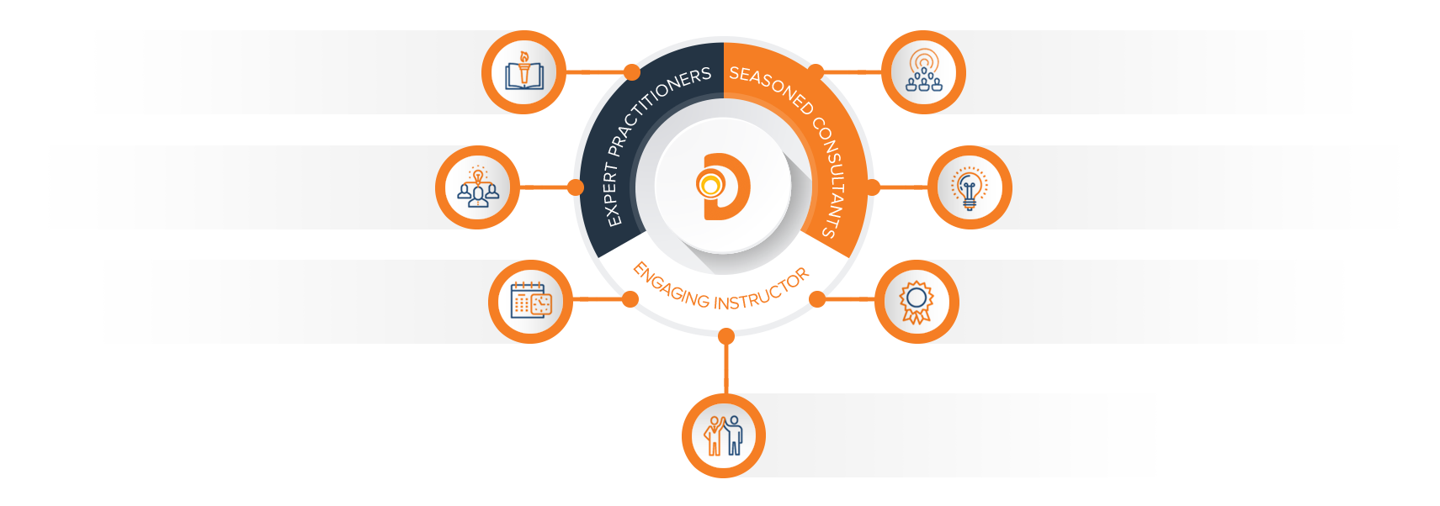
Our Practitioners
250 best selling
books authored
150 engagements speaking
at industry conferences
9+ years of training
experience
Over 17 years of industry
experience per instructor
750,000 practitioner led
training hours
125 certifications in leading
technologies
95% instructor satisfaction

Slide 5
TDD and CI/CD
Fernando Pombeiro
Instructor

Slide 6
About the Instructor
Six years military with a couple of tours in Iraq and Afghanistan (Navy)
Got out and joined Amazon.com in operations in 2006
Spent four years learning to code
Picked up MYSQL, PHP and Unix command line
2010: Joined first startup (Meteor Games) as a backend developer in PHP/MYSQL (FLASH was the front end)
Made Farmville-type games
Company closed down in 2012
2012: Joined another startup (Playsino) making online card games still on PHP/MYSQL/Flash. Started with Python
This one lasted until 2013

Slide 7
About the Instructor
2013: Joined The Leaf Group as a Big Data engineer
Learned Python, Hadoop, Java
Spent a lot of time in data analysis
2015: Joined NBCUniversal (Fandango) as a Data Engineering Manager
Picked up AWS, Java, Docker
Joined Develop Intelligence part time
2017: Moved to the UK and started as an independent contractor
Currently doing Node.js, Docker, GOLANG and Snowflake with AWS
Also doing a lot more work with Develop Intelligence in back end tech

Slide 8
Class Overview
Our goal is to go over the creation and maintenance of an effective Continuous Integration and Continuous Development Pipeline
As part of this we will be utilizing the following tools:
Python
Github
AWS Code Pipeline
Docker
By the end of this class students should be able to understand CI/CD concepts and create effective pipelines for coders

Slide 9
How we will accomplish this
The class will be broken out into several modules. The goal is to get through TWO modules a day over three days (so…six modules)
The modules are made up of:
A lecture portion
A lab portion (practical)
The modules will cover the following topics:
MODULE ONE:
Test Driven Development fundamentals
MODULE TWO:
Test Driven Development advanced (mocking)

Slide 10
How we will accomplish TDD (continued)
MODULE THREE
Version Control (and hooks)
Introduction to continuous Integration
MODULE FOUR
Build agents (AWS Code Pipelines)
Deployment from Version control
MODULE FIVE
Creating an AWS code pipeline for Integration
Continuous Deployment practical
MODULE SIX:
Practical: Pulling the entire pipeline together

Slide 11
Introduction to TDD

Slide 12
Test Driven Development
Hypothetical:
Your boss comes to you and asks you to create code that reads from an API and puts that data into a database.
You have the skills and you sit down at the desk and begin typing.
What do you start with?
What is your plan?
How do you verify that things are working?

Slide 13
Test Driven Development
MOST people are going to sit down and immediately start coding
We’re engineers- it’s what we’re paid to do! So why wouldn’t we immediately start in on coding effectively?

Slide 14
Test Driven Development
Who here remembers your first coding experience?
Maybe you were coding a game?
An Application?
Remember what the results looked like?
Did you have a mentor?
Did you have a plan?
Did you have much of an idea of what you intended to do?

Slide 15
Test Driven Development

Slide 16
Test Driven Development
Unless you were a coding genius of unparalleled talent I’m going to guess that none of us would be proud of their first efforts at coding.
In fact, I’m guessing that your first coding efforts were a mess of procedural code all written in the “MAIN” function without any stops or changes.
That’s fine! We all start somewhere BUT…think about what you’ve learned since then!!

Slide 17
Test Driven Development
Remember the first time you read through an elegantly coded application?
Something where the coder had utilized functions and followed concepts like DRY (Don’t Repeat Yourself) to create functions that could be used again and again thereby avoiding the need to reuse things like GOTOs or just having to repeat large chunks of code again and again?
Remember your first exposure to bite-size chunks of code (the functions within Objects, or Objects themselves) that flowed one into another?

Slide 18
Test Driven Development
So what’s the difference between the coder you (most likely) are today and the coder you were back then?
What have you learned that has served you best?
Do you have a favorite coding concept that made everything ”click” for you?
Abstraction?
Encapsulation?
Inheritance?
Polymorphism?
Interfaces?
Memoization?

Slide 19
Test Driven Development
What differentiates a senior developer from a junior developer?
Why do senior developers make more? Why are they generally more sought after?
What separates senior and junior developers?
The ability to plan*
*NOT “follow a plan”- anyone can do that! A senior developer can make a plan.

Slide 20
Test Driven Development

Slide 21
Test Driven Development (continued)

Slide 22
Test Driven Development

Slide 23
Test Driven Development

Slide 24
Test Driven development
AND THIS is what Test Driven Development is really about
PLANNING

Slide 25
TDD How To

Slide 26
Test Driven Development (How To)
So now that you are a “senior” coder you have probably eschewed the technique of coding out one looooooong block of code.
Instead: most likely you are using small functions for your code:
Function A returns value B which is the input parameter for Function C
SO- instead of a long string of gobbledygook your code for a coding challenge that asked for you to “add two numbers together then DOUBLE THEM” looks like:

Slide 27
#I’m fairly junior
def add_together_and_double(a,b):
c = a + b
d = c * 2
return d

Slide 28
Test Driven Development (How To)
#I KNOW WHAT I’M DOING
def add_together(a,b):
return a + b
def double_them(val):
return val * 2
if __name__ == “__main__”:
a = add_together(5,6)
print(double_them(a))

